Slide 1
Survival Analysis of PBC Patients
By
Chukwuma Franklin Ofoegbu
S211235
Event History Analysis

Slide 2
agenda
INTRODUCTION 3
DATA DESCRIPTION 4
KAPLAN-MIER ANALYSIS & LOGRANK TEST 5
COX-PH MODEL & FURTHER TESTS 10
CONCLUSION 13

Slide 3

introduction
The liver is an organ that is located on the upper right belly. It is a crucial organ, which supports metabolism and engages in secretory functions. The liver is reddish-brown, and is about the size of a football, below the ribcage.
The liver supports immunity, digestion, detoxification, metabolism, vitamin storage, bile production and a host of other functions. The liver is about 2% of an adult body’s weight.

Slide 4
introduction
Primary biliary cirrhosis (pbc) also known as primary biliary cholangitis is a liver disease that primarily affects the bile ducts. Biliary means bile ducts, cholangitis means inflammation in the bile ducts. This disease is a chronic and progressive one and can get worse over time.
Liver transplant can fix this, but more so, there are drugs which can be used to slow down the progression of the disease.

Slide 5
introduction
This study explores the effects of the drug D-penicillmain, in PBC patients. The survival analysis of these patients.

Slide 6
data description

Slide 7
data description
This data is from the Mayo Clinic trial in primary biliary cirrhosis (PBC) of the liver conducted between 1974 and 1984. A total of 424 PBC patients, referred to Mayo Clinic during that ten-year interval, met eligibility criteria for the randomized placebo-controlled trial of the drug D-penicillamine. The first 312 cases in the data set participated in the randomized trial and contain largely complete data. The additional 112 cases did not participate in the clinical trial but consented to have basic measurements recorded and to be followed for survival.

Slide 8
data description
Parameter | Description
age: | in years
albumin: | serum albumin (g/dl)
alk.phos: | alkaline phosphotase (U/liter)
ascites: | presence of ascites
ast: | aspartate aminotransferase, once called SGOT (U/ml)
bili: | serum bilirunbin (mg/dl)
chol: | serum cholesterol (mg/dl)
copper: | urine copper (ug/day)
edema: | 0 no edema, 0.5 untreated or successfully treated
 | 1 edema despite diuretic therapy
hepato: | presence of hepatomegaly or enlarged liver
id: | case number
platelet: | platelet count
protime: | standardised blood clotting time
sex: | m/f
spiders: | blood vessel malformations in the skin
stage: | histologic stage of disease (needs biopsy)
status: | status at endpoint, 0/1/2 for censored, transplant, dead 0 = censored;transplant 1 = death
time: | number of days between registration and the earlier of death,
 | transplantion, or study analysis in July, 1986
trt: | 1/2/NA for D-penicillmain, placebo, not randomised
trig: | triglycerides (mg/dl)

Slide 9
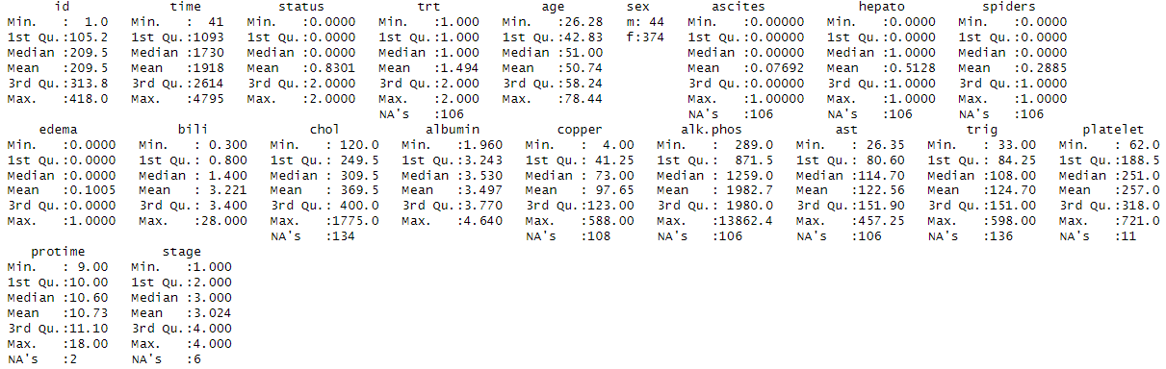
data description
Full dataset (418 Patients)

Slide 10
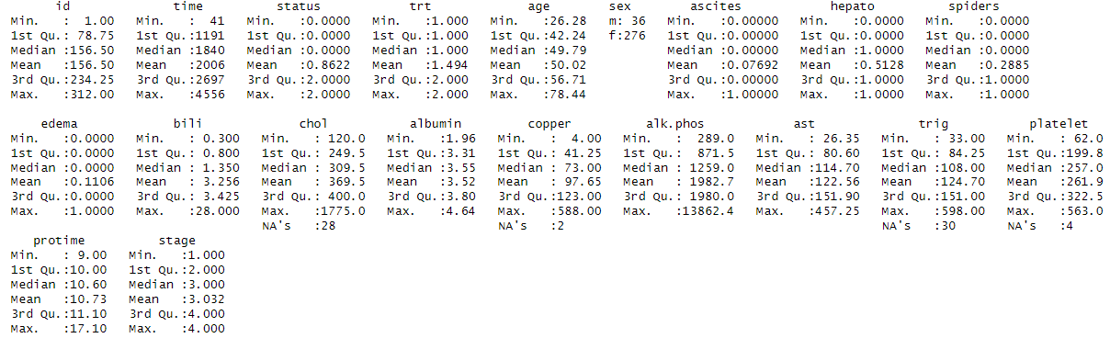
data description
Clinical Trial (312 Patients)

Slide 11
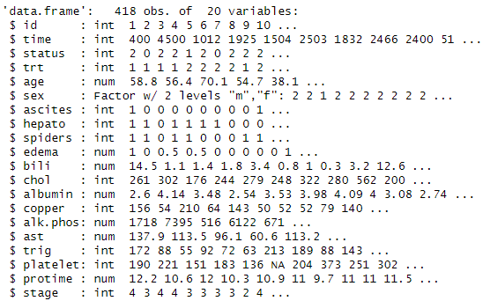
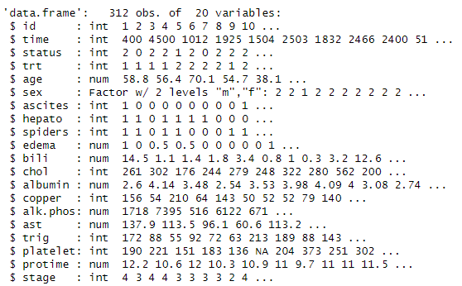
data description
A new variable named AG is introduced. This is for the age. If age is less than 50 years, then AG = LT50, else age = OV50.

Slide 12
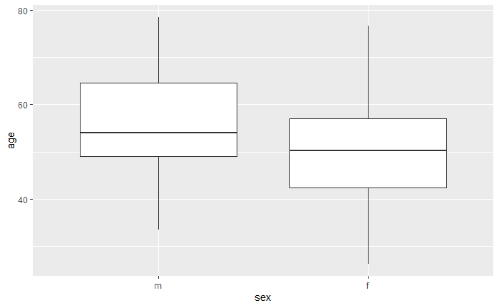
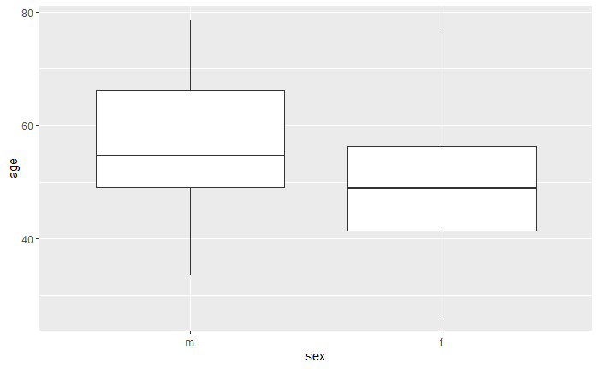
data description
Box Plot – Age (m vs f; full vs partial).

Slide 13
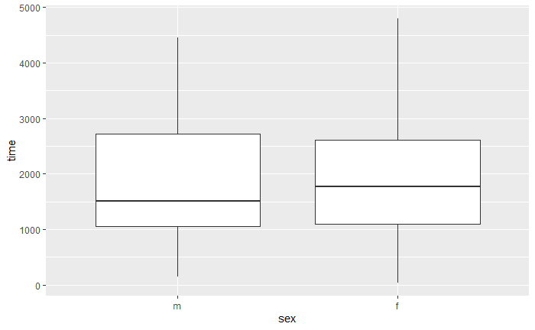
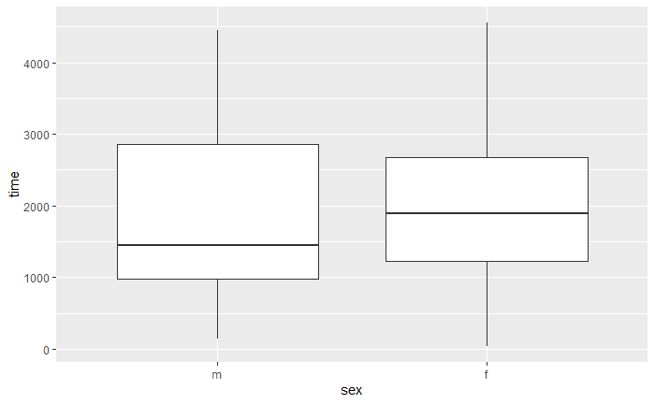
data description
Box Plot – time (m vs f; full vs partial).

Slide 14
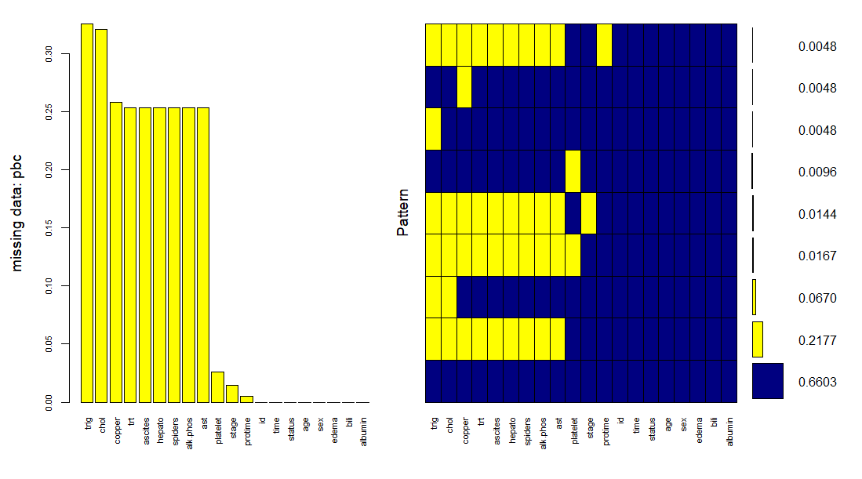
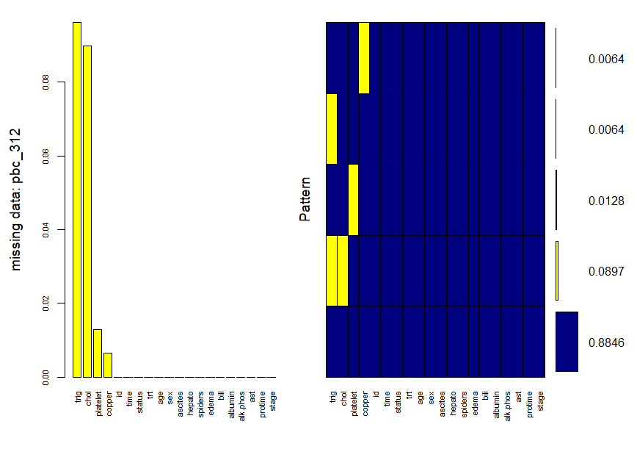
data description
Missing Data (full vs partial).

Slide 15
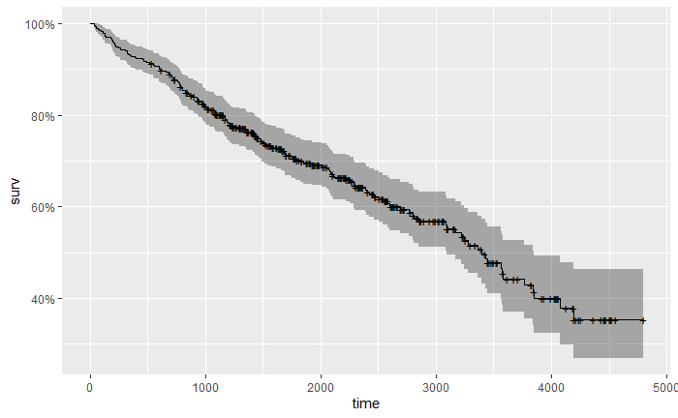
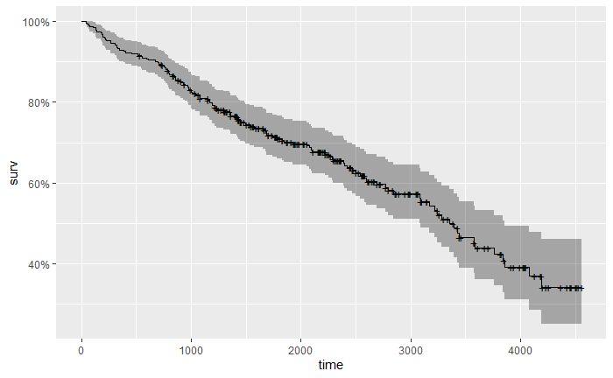
kaplan-meier analysis

Slide 16
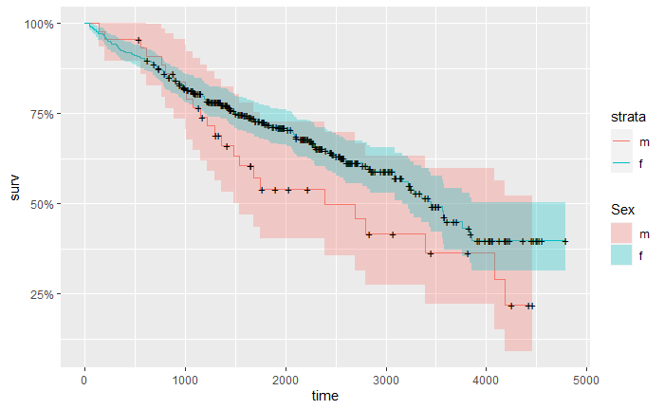
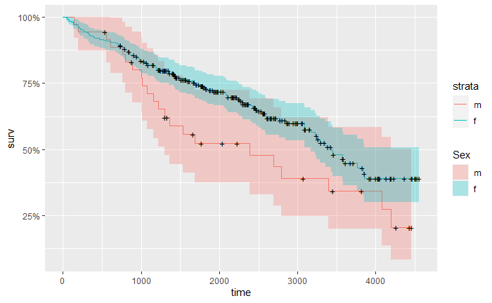
kaplan-meier analysis
KP - sex(full vs partial).

Slide 17
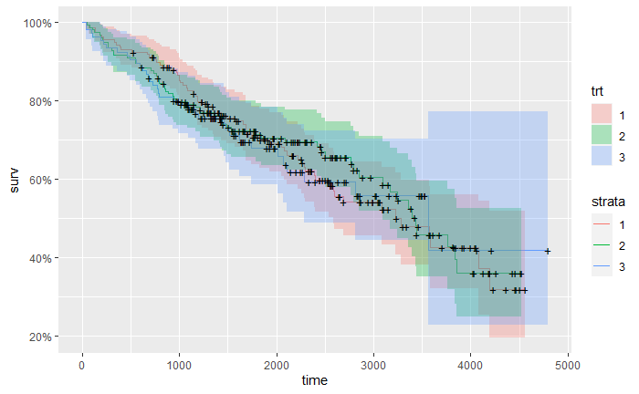
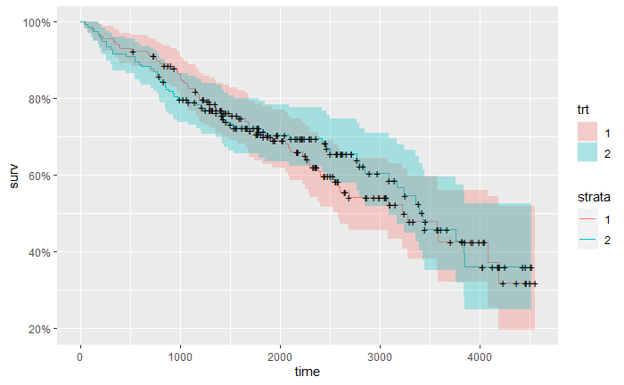
kaplan-meier analysis
trt (full vs partial).

Slide 18
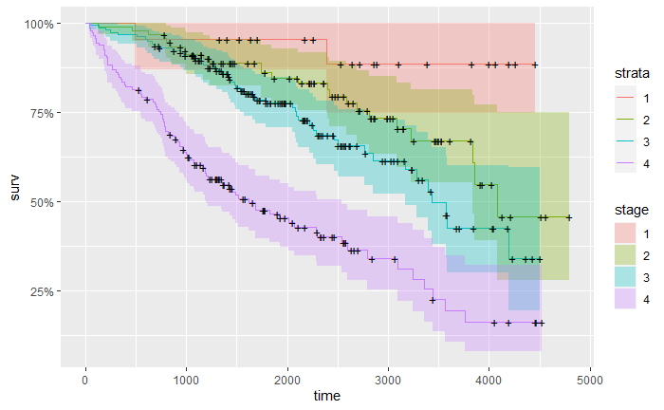
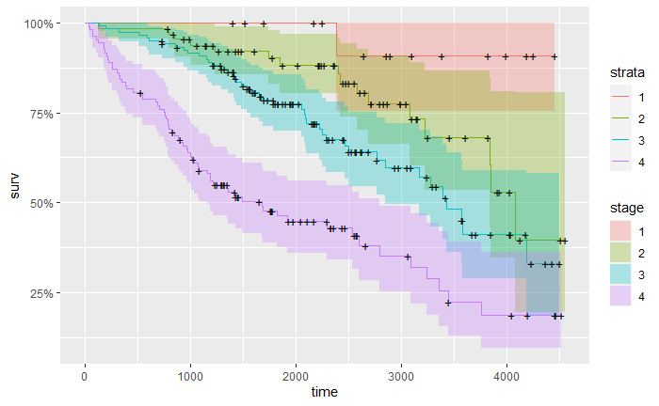
kaplan-meier analysis
stage (full vs partial).

Slide 19
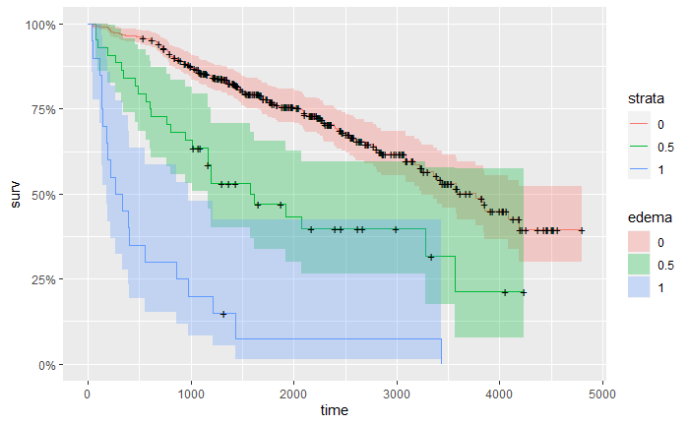
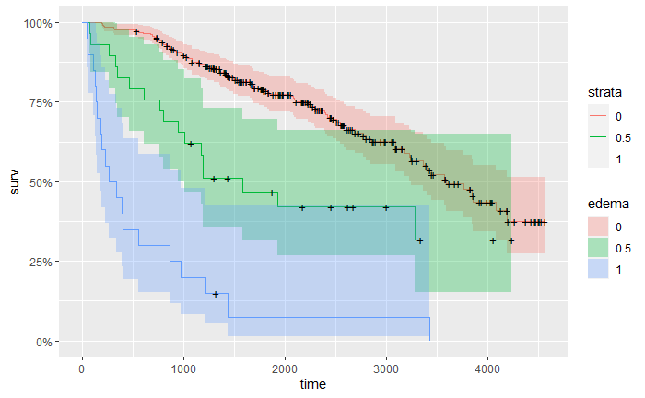
kaplan-meier analysis
edema (full vs partial).

Slide 20
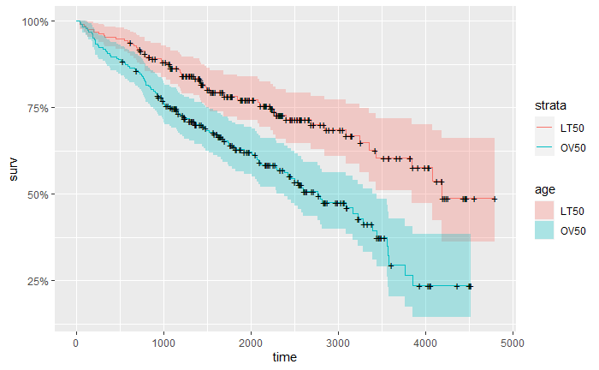
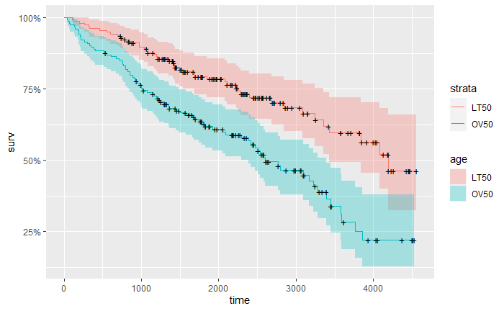
kaplan-meier analysis
age(full vs partial).

Slide 21
logrank analysis

Slide 22
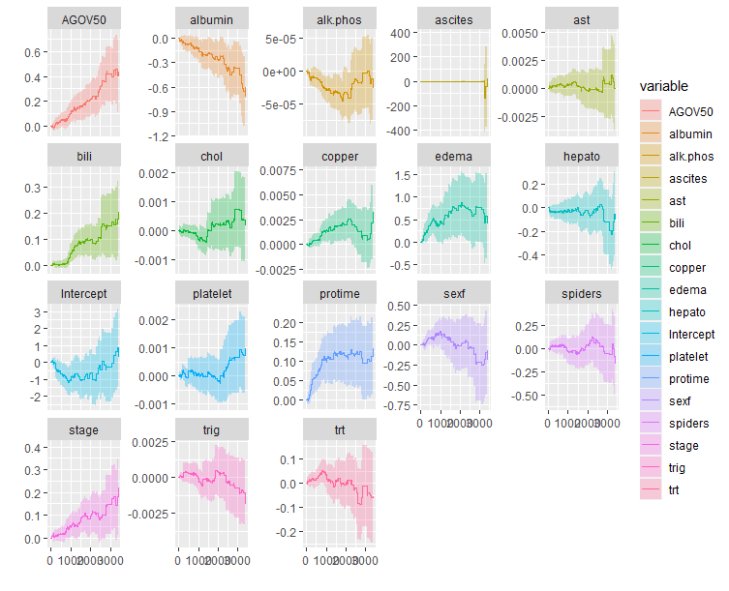
cox PH model

Slide 23
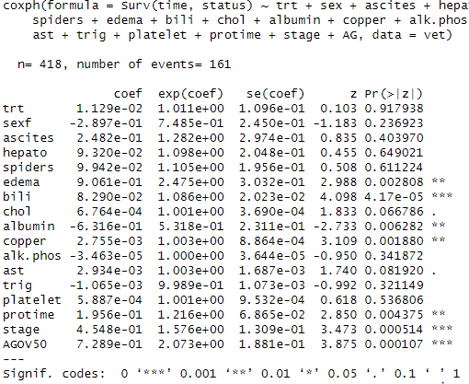
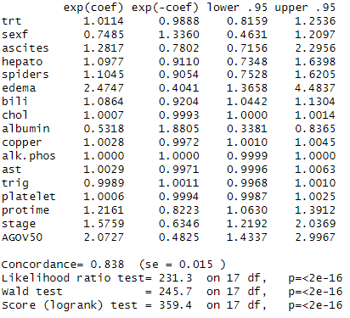
cox PH model

Slide 24
Cox PH Model
Hazard increasing over time: AGOV50, ascites, bili, edema, platelet, protime, stage.
Hazard decreasing over time: albumin, sexf,
While the rest variables have little or no changes/impact on the survival over time.
Patients aged over 50, with edema and high ascites have the biggest NEGATIVE impact on the survival of patients.
h(t,X)=ho (t)exp⁡[β1 X1+β2 X2+β3 X3+⋯+β16 X16+β17 X17]
Coef (βi) : Full Data set
[1.011, 0.749,1.282, 1.098, 1.105, 2.475, 1.086, 1.001, 0.532, 1.003, 1.000, 1.003, 0.999, 1.001, 1.216, 1.576, 2.073] = [β1, …, β17]
Coef (βi) : Full Data set
[0.8986,0.6839,1.3701,1.2136,1.1031, 2.3468,1.0801,1.0005,0.4678,1.0026,1,1.0047,0.9993,1.0003,1.3081, 1.4301, 2.0783] = [β1, …, β17]

Slide 25
Log-log plots

Slide 26
Parametric models

Slide 27
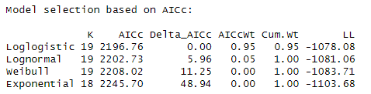
AIC and LL

Slide 28
AIC and LL

Slide 29
Conclusion
In conclusion, it is seen that the treatment drug (d-penicillamine) has almost no visible effects on PBC patients, further supported by these articles (https://www.ncbi.nlm.nih.gov/pmc/articles/PMC8846335/ and https://pubmed.ncbi.nlm.nih.gov/3905561/ ) which says that PBC has negative and no effects respectively. As the stage of PBC worsens, the survival rate becomes also worse. The age of PBC patients (>50 years), as the PBC patient becomes older, his survival rate decreases (Older PBC patients die quicker than younger ones).
The best model is the loglogistic model.

Slide 30
thank you
Franklin Chukwuma Ofoegbu

